Slide 1
SP/01
RASMAG STUDY ON THE EFFECT OF AIDC AND APANPIRG CONCLUSIONS
Secretariat - APAC OFFICE
28 October 2014
SIP AIDC Seminar in Bangkok

Slide 2
OUTLINE
RASMAG Review Effectiveness of AIDC for LHDs
use case between Japan and ROK;
APANPIRG Conclusions on AIDCs.

Slide 3
RASMAG
Many RVSM Large Height Deviations (LHDs) are being reported to RASMAG. (2009)
LHD – Any vertical deviation of 90m/300ft or more from the flight level expected to be occupied by the flight.
The use of AIDC has long been advocated by RASMAG as a way of reducing ATC unit to ATC unit coordination errors.

Slide 4
AIDC Implementation
AIDC has been implemented among the area control centres (ACCs) of Japan and the Republic of Korea since 15 June 2009. RASMAG reviewed the effect on the occurrence of Large Height Deviations (LHDs) before and after the implementation of AIDC.

Slide 5
RASMAG REVIEW
Japan and the United States (Regional Monitoring Agency – RMA responsible for ROK) conducted analyses on occurrences of HF caused by ATC-to-ATC Transfer errors.

Slide 6
Analysis on B576
Japan and the United States focused on ATS route B576 (shown on map next slide)
B576 – bidirectional and 228 aircraft movement per day at that time.

Slide 7
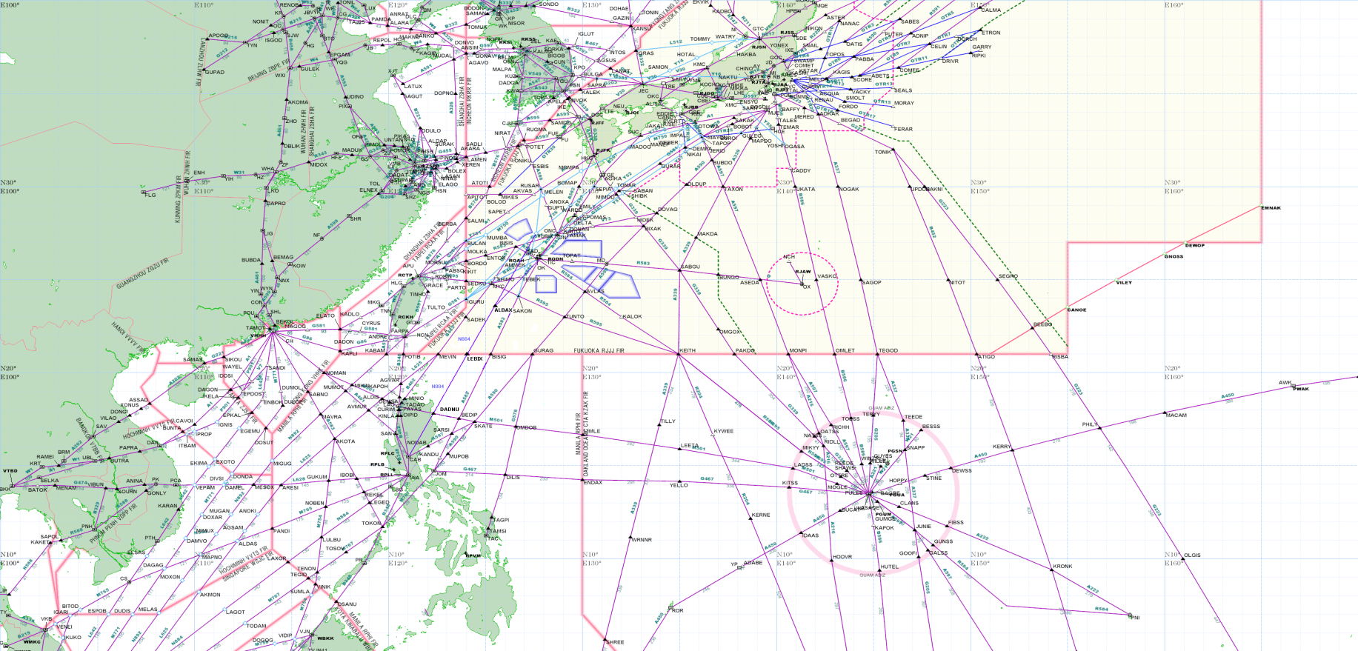
B576

Slide 8
Summary of LHD Occurrences and Duration
A total of 26 LHD events - from 1 August 2008 to 31 May 2010.
Table (next slide) shows the summary of occurrences in terms of numbers and duration.

Slide 10
Findings
16 LHDs in 11 months before the AIDC implementation
vs.
10 LHDs in 11 months after the AIDC implementation
Significant reduction however not perfect

Slide 11
Event Date | Source | Location of Deviation | Duration of LHD (min) in Incheon FIR | Code
21-Jul-09 | Naha ACC | ATOTI (B576) | 0 | E
19-Aug-09 | Incheon ACC | SADLI (A593) | 0.08 | E
23-Aug-09 | Incheon ACC | ATOTI (B576) | 0.08 | E
21-Sep-09 | Naha ACC | ATOTI (B576) | 0 | E
1-Oct-09 | Naha ACC | ATOTI (B576) | 0 | E
15-Nov-09 | Naha ACC | ATOTI (B576) | Unknown | E
7-Dec-09 | Naha ACC | ATOTI (B576) | 0 | E
21-Jan-10 | Naha ACC | ATOTI (B576) | 0 | E
26-Jan-10 | Naha ACC | ATOTI (B576) | 0 | E
11-May-10 | Fukuoka | ATOTI (B576) | Unknown | E

Slide 12
Conclusions
RASAMG – continues the study of effect of AIDC to improve safety.
AIDC – not perfect at the time however a powerful tool to reduce the LHDs between ATC units.
APANPIRG Conclusion 18/3 – noting the continued prevalence of the RVSM LHD occurrences resulting from ATC unit/ATC unit coordination errors as reported by RMAs, …..
States – urged to implement compatible AIDC capabilities as soon as possible.

Slide 13
APANPIRG Conclusions on AIDCs
Conclusion 19/19 – Implementation of AIDC in Asia and Pacific Regions
That, States be urged to expedite implementation of AIDC between neighboring ATS facilities in accordance with the Regional Air Navigation Plan and the Asia/Pacific AIDC/ICD.
Conclusion 24/17 – AIDC Implementation
….. States should
Engage as soon as possible in AIDC trials to develop knowledge and address any
related ATM or communications system issues;
b) Implement operational AIDC messaging as a matter of priority, in accordance
With APANPIRG 19/19; and
c) Implement as far as practical, the AIDC messages – ABI, EST, ACP, TOC & AOC.

Slide 14
APANPIRG Conclusions on AIDCs
Conclusion 24/27 – Prioritization of AIDC Implementation to Address LHDs
Considering that AIDC is an important means of minimizing Large Height Deviations (LHD), Asia/Pacific States should support the expedition of AIDC through collaborative project at the following significant LHF interfaces areas:
Indonesia: between Jakarta and Chennai/Ujung Pandang/Brisbane/Melbourne FIRs;
India: between Chennai and Kuala Lumpur FIRs;
Philippines: between Manila and Fukuka/Taipei/Hong Kong/Ho Chi Minh/Singapore/Kota Kinabalu/Ujung Pandang FIRs; and
China: between
- Urumqi and Lahore FIRs; and
- Beijing and Ulaan Baatar FIRs.

Slide 15
APANPIRG Conclusions on AIDCs
Conclusion APANPIRG 25/38 – Harmonization for AIDC Implementation
That, States/Administrations in the APAC Region be urged to share their implementation plans and experiences with concerned States for an expeditious AIDC implementation in a harmonized and timely manner.
Also APANPIRG made Decision 25/37 – establishment of AIDC Implementation Task Force focusing facilitation of AIDC Implementation in the BoB and ScS sub-regions.

